Slide 1

Topic 4: Functionals and purrr

Slide 2
Course Overview
Topic | Description
Session 1
1 | Introduction to R and R Studio Cloud
2 | Exploratory Data Analysis: the tibble and ggplot2
3 | Functions, Vectors and Lists
4 | Introduction to Functionals with purrr
5 | Data Transformation I with dplyr
Session 2
6 | Data Transformation II with dplyr
7 | Statistical Transformation with ggplot2
8 | Advanced Functionals and Modelling with purrr
9 | Exploratory Data Analysis - Case Study using aimsir17

Slide 3
Functionals
Data
A functional is a function that takes data and a function as inputs, and returns a vector as output
The output is usually the same size as the input.
Commonly used as an alternative for loops
The purrr package contains an excellent resource for functionals
Function
A Functional
Transformed
Data

Slide 4
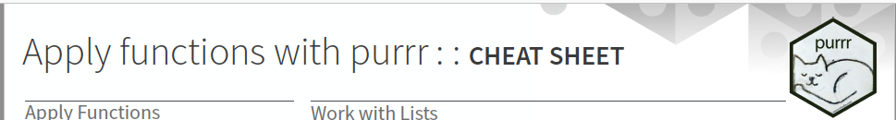
Introduction to purrr
http://www.rebeccabarter.com/blog/2019-08-19_purrr/
purrr is all about iteration.
purrr introduces map functions (the tidyverse’s answer to base R’s apply functions, but more in line with functional programming practices) as well as some new functions for manipulating lists

Slide 5
Introduction to purrr
http://www.rebeccabarter.com/blog/2019-08-19_purrr/
While the workhorse of dplyr is the data frame, the workhorse of purrr is the list.
A vector is a way of storing many individual elements (a single number or a single character or string) of the same type together in a single object,
A data frame is a way of storing many vectors of the same length but possibly of different types together in a single object
A list is a way of storing many objects of any type (e.g. data frames, plots, vectors) together in a single object

Slide 6
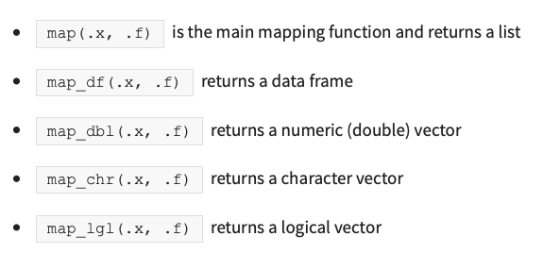
(1) Map functions
A map function is one that applies the same action/function to every element of an object (e.g. each entry of a list or a vector, or each of the columns of a data frame)
The naming convention of the map functions are such that the type of the output is specified by the term that follows the underscore in the function name
Consistent with the way of the tidyverse, the first argument of each mapping function is always the data object that you want to map over, and the second argument is always the function that you want to iteratively apply to each element of the input object

Slide 7
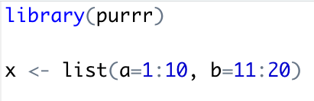
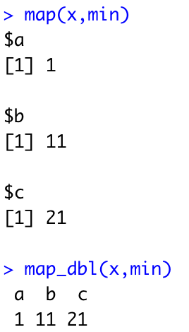
The input object
The input object to any map function is always either
a vector (of any type), in which case the iteration is done over the entries of the vector,
a list, in which case the iteration is performed over the elements of the list,
a data frame, in which case the iteration is performed over the columns of the data frame (which, since a data frame is a special kind of list, is technically the same as the previous point).

Slide 8
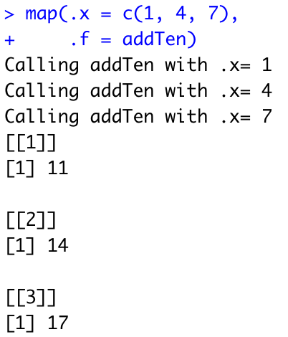
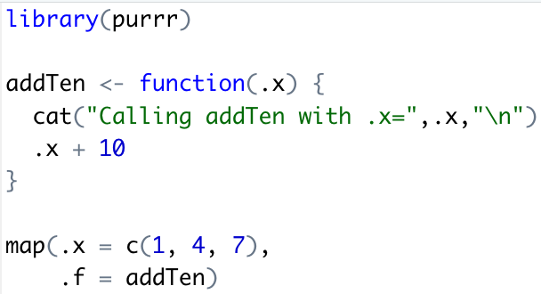
Iteration example

Slide 9
The output
The first element of the output is the result of applying the function to the first element of the input (1),
The second element of the output is the result of applying the function to the second element of the input (4),
The third element of the output is the result of applying the function to the third element of the input (7).

Slide 10
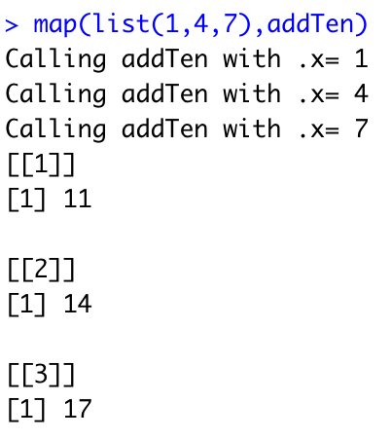
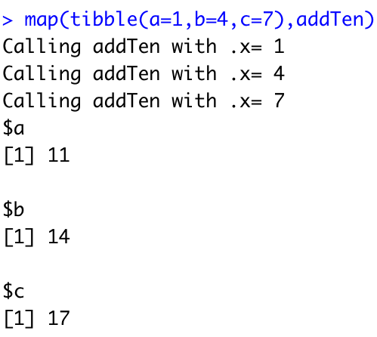
map() always returns a list

Slide 11
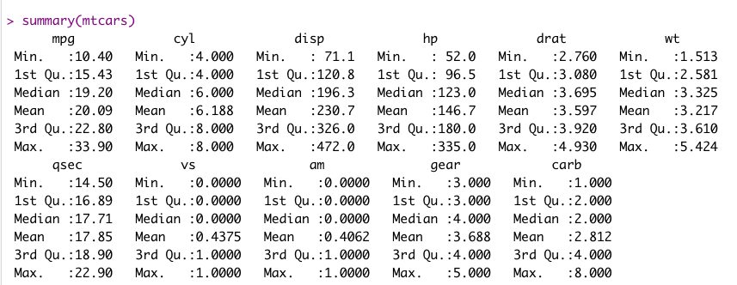
Challenge 4.1
For the data frame mtcars, get the mean values for each column, using map()

Slide 12
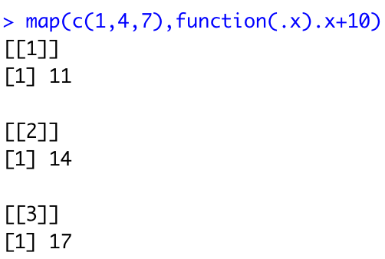
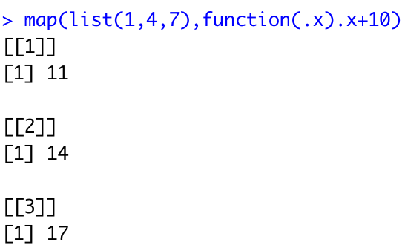
(2) Adding Anonymous Functions

Slide 13
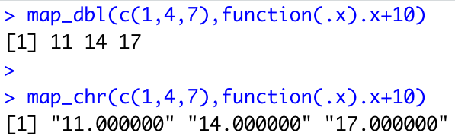
Modifying the output from map
If we wanted the output of map to be some other object type, we need to use a different function.
For instance to map the input to a numeric (double) vector, you can use the map_dbl() (“map to a double”) function

Slide 14
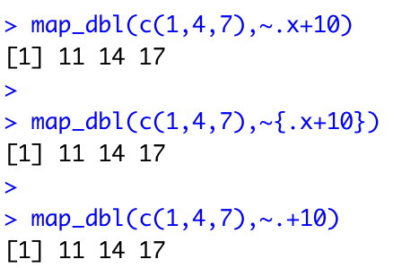
(3) The tilde-dot shorthand for functions
To make the code more concise you can use the tilde-dot shorthand for anonymous functions (the functions that you create as arguments of other functions).
~ indicates that you have started an anonymous function, and the argument of the anonymous function can be referred to using .x (or simply .).
Unlike normal function arguments that can be anything that you like, the tilde-dot function argument is always .x.

Slide 15
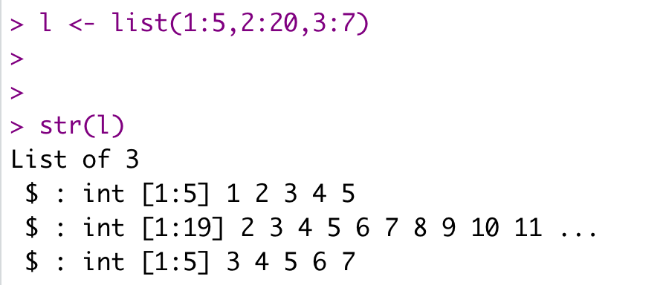
Challenge 4.2
Write a map function that takes in a list of vector elements, and then returns (as an integer) the number of elements in each list
Use the ~ operator to perform the same task

Slide 16
Challenge 4.3
Use the interval [-10,10] for x, and the seq() function to generate the values in steps of 0.1
Generate the response f(x) by calling map_db()
Create a tibble with the x, f(x) output
Plot the response using ggplot2
f(x) = ax² + bx + c

Slide 17
